Slide 1

NIH Survey Trend Analysis:
Increasing EMR presence
Varun Maheshwari
Liautaud Business School, University of Illinois at Chicago

Slide 2
Technology Assessment Model
Screening Variable
ProviderMaintainEMR2 (D1)
UseInternet (B1)
EverOfferedAccessRec (D4)
Health Related
MostRecentcCheckup (C2)
FreqGoProvider (C3)
Chronic Medical Conditions (G3)
Data Privacy Concern
ConfidentInfoSafe (D2)
Target Variable
AccessOnlineRecord (D6)
Demographics
Age (O1) ,OccupationStatus(O2), ActiveDutyArmedForces (O3)
MaritalStatus (O5), Education (O6), Ethnicity(2 Questions) (O10,O11), ChildrenInHH, (O15) IncomeRanges(O17), Totalhousehold(O13)
Technology Related
Use internet health related activities (B5)
OtherDevTrackHealth (B9)
Whereseekhealthinfo (A2)
Lifestyle
TimesModerateExercise (I1) MostRecentCheckup2 (C2)

Slide 3
Screening Variables
Variable name | Survey Question | Data Type | Treatment
ProviderMaintainEMR2 | D1 | Categorical | Remove people who said “No” (91), Put -9 and -5 (missing and errored values) into 3 (Don’t know)
UseInternet | B1 | Binary | (yes = 1, no =0) only 35 people use EMR that said no Remove 2
EverOfferedAccessRec | D4 | Categorical | No Access to EMR will not use it Remove 2 and 3

Slide 4
Target Variable - Cleaning
AccessOnlineRecord | D6 | Categorical | Remove -9, -2, -1
3 approaches:
Binary Target
2 levels: 0 (Never accessed EMR) as ‘0’ 1,2,3,4 (Accessed EMR once or more) as ‘1’
Ordinal Target 3 categories: 0 (Never accessed) as ‘0’ 1,2 (Accessed 1-5 times) as ‘1-5 times’ 3,4 (Accessed more than 6 times) as ‘6+ times’
Multinomial Target 5 categories: 0,1,2,3,4 (as given)

Slide 5
Demographic Variables - Cleaning
Age | O1 | Numerical: Converted into Categorical Base: 60+ | Replace -9 with median: 55 Age category (new column): <30, 30-45, 45-60, 60+
OccupationStatus | O2 | Categorical Base:1 (Employed) | 1,2,3,4,5,6, 91 (Other: Clubbed -5 and -9)
ActiveDutyArmedForces | O3 | Categorical Base: 0 (Never active) | 1,2,3: 1 (active some point) 4+5: 0 (never active) -9: missing group
MaritalStatus | O5 | Categorical Base: 6 (Single) | -5 and -9 = 0 1,2,3,4,5,6
Education | O6 | Categorical Base: 1 (Less than HS) | Clump 1 and 2 into 1 (less than high school) 2-6 for rest of categories -9=0
Totalhousehold | O13 | Categorical Base: 1 (1 person) | 1,2,3,4+, unknown

Slide 6
Demographic Variables - Cleaning
Hisp_Cat | O10 | Categorical Use only Hisp_Cat (No dependency) Base: Not Hispanic | Unknown (-9) Not Hispanic (10) Hispanic (21,22,23,24,25) Data was unbalanced (very few Hispanic) 10 = not hispanic , 21= Mexican, 22= puerto Rican, 23=Cuban, 24= other hispanic, 25= multiple hispanic, -9 = another bucket
Race_Cat2 | O11 | Categorical Use only Race_Cat Base: White | Unknown (-9) White (11) Black (12) Others (14, 16,31, 32, 33, 34, 35, 36, 37, 52, 54, -9) Data was unbalanced (very few other) 11 = white, 12 = black, 14 = american indian, 16 = multiple races, 31 = asian indian, 32= chinese, 33= Filipino, 34= Japanese, 35= Korean, 36= Vietnamese, 37 = Other Asian, 52= Guamanian or Chamorro, 54= Other pacific Islander -9 = no answer
ChildrenInHH | O15 | Categorical Base: 0 | 0 (0), 1+ (1,2,3,4..8), Unknown(9)
IncomeRanges | O17 | Categorical Base: 1 | 0 (unknown), 1-4 (low), 5-6 (moderate), 7-9 = (high)

Slide 7
Health Related Variables - Cleaning
FreqGoProvider | C3 | Categorical Base: 0 | 0,1,2,3,4,5,6, -9
MedConditions_Diabetes, MedConditions_HighBP, MedConditions_HeartCondition, MedConditions_LungDiseases, MedConditions_Arthritis, MedConditions_Depression | G3 | All binary variables clubbed into one category Base: 0 | Variable IsChronic: If all answers are ‘No disease’, then= 0 If any 1, then= 1 -9: Unknown
MostRecentCheckUp2 | C2 | Categorical Base: 1 | 1, 2,3+ (3,4,5), 6 = Don’t know

Slide 8
Technology Related Variables - Cleaning
Electronic_SelfHealthInfo, Electronic_HealthInfoSE, Electronic_buyMedicine, Electronic_LookedAssistance, Electronic_TalkDoctor, Electronic_TrackedHealthCosts, Electronic_TestResults | B5 | Ordinal Base is 0 | TechSavvy: Ordinal additive variable If all unknown: -9 For any 0: add 0, for any 1: add 1 Final categories: 0,1,2,3,4,5,6,7,-9
Whereseekhealthinfo | A2 | Categorical Base: ‘Not uses’ | Unknown, uses internet, does not use internet
OtherDevTrackHealth | B9 | Binary Base is 0 | 2 = 0(no) 1 = 1(yes) -9 = unknown

Slide 9
Security Related Variables - Cleaning
Lifestyle Related Variables - Cleaning
ConfidentInfoSafe | D2 | Ordinal Reverse Code Base: 1 | 3 → High Confident 2 → Somewhat Confident 1 → Not Confident -9 and -5 = unknown = 0
TimesModerateExercise | I1 | Categorical Base: None | None = 0 1-2 (low exercise level) = 1 3-4 (moderate) = 2 5-7 (high) = 3 Unknown = -9

Slide 10
Logistic Regression- Binomial
Interpretations:
Tech Savvy: (B5)
#Tech_savvy2 1.12709 0.34964 3.224 0.00127 **
#Tech_savvy3 1.97556 0.35257 5.603 2.10e-08 ***
#Tech_savvy4 3.20274 0.36461 8.784 < 2e-16 ***
#Tech_savvy5 3.83389 0.38542 9.947 < 2e-16 ***
#Tech_savvy6 3.72819 0.39461 9.448 < 2e-16 ***
#Tech_savvy7 4.69926 0.58780 7.995 1.30e-15 ***
Incomeranges: (O17)
#incomerangesHigh 0.60251 0.22407 2.689 0.00717 **
#incomerangesUnknown 0.83013 0.30182 2.750 0.00595 **
Confident into safe: (D2)
#confidentinfosafe2 0.39986 0.19307 2.071 0.03835 *
#confidentinfosafe3 0.63149 0.20319 3.108 0.00188 **
Marital status: (O5) maritalstatus5 -1.53089 0.52561 -2.913 0.00358 **
Frequgoprovider: (C3)
#freqgoprovider4 0.71934 0.30779 2.337 0.01943 *
#freqgoprovider5 0.67197 0.30168 2.227 0.02592 *
Variable | Level of the variable | Access EMR | With respect to
Tech savvy | Nature increases | More likely | Non- tech Savvy
Income Ranges | Above 75k | More likely | Below 35k
Confident about privacy | Yes | More likely | Not confident
Marital Status | Separated | Less likely | Single
Frequency to go to the provider | 4-9 times | More likely | Who did not visit at all

Slide 11
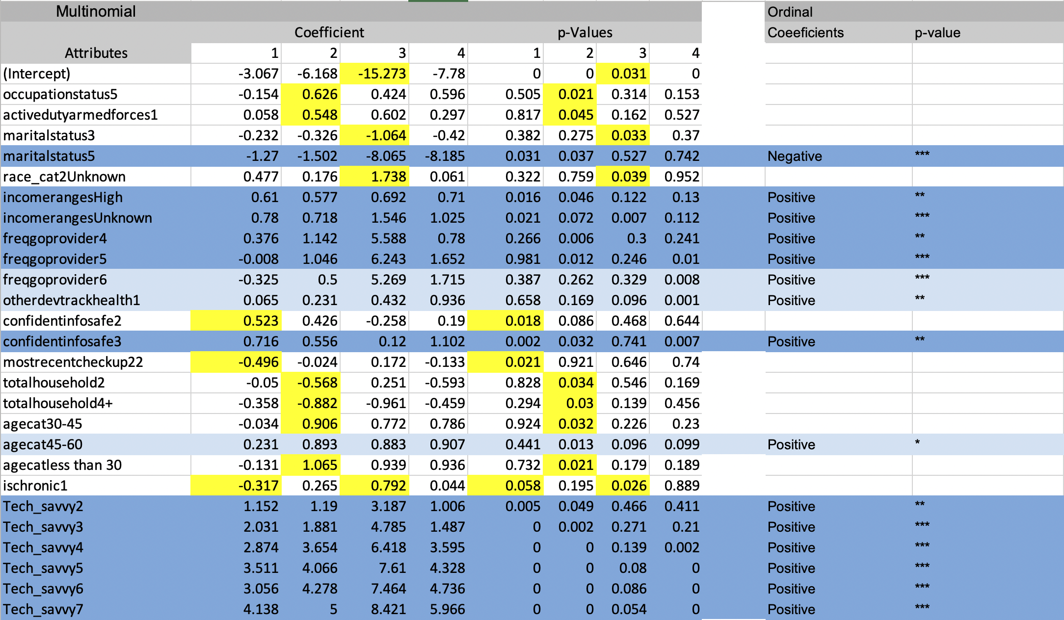
Logistic Regression- Multinomial and Ordinal
Yellow: Significant for only multinomial Light blue: Significant for only multinomial and ordinal Dark blue: Significant in all 3 models

Slide 12
Extra Findings From Models
Multinomial and Ordinal
Variable | Level of the variable | Access EMR | With respect to
Age category | 45-60 | More likely | >60
Having a device to track health | Yes | More likely | No
Frequency to go to the provider | More than 9 times | More likely | Who do not visit at all

Slide 13
Multinomial Only
Variable | Level of the variable | Access EMR | With respect to | Target Variable
Is chronic | Yes | Less likely | Not chronic | Access it 1-2 times than never
 | Yes | More likely | Not chronic | Access it 6-9 times than never
Age category | Less than 30 | More likely | More than 60 | Access it 3-5 times than never
 | 30-45 | More likely | More than 60 | Access it 3-5 times than never
Total household | 4+ | Less likely | Than 1 | Access it 3-5 times than never
 | 2 | Less likely | Than 1 | Access it 3-5 times than never

Slide 14
Most recent checkup | 1-2 years ago | Less likely | Within the last year | Access it 1-2 times than never
Marital Status | Divorced | Less likely | Single | Access it 6-9 times than never
Active Duty Armed Forces | Yes | More likely | No | Access it 3-5 times than never
Occupational Status | Retired | Less likely | Employed | Access it 6-9 times than never
**In this case, multinomial model is better for capturing differences in levels of categorical variables as it covers higher variance from the given data due to granular level distribution of target variable.

Slide 15

Audience to be targeted
Have high income and access to HMO insurance plans
Are single as compared to separated or divorced
Go to their provider frequently: 4+ times in a year
Are confident about data privacy
Are Tech Savvy (> 2 /7)
Have regular check-ups (most recent within last year)
Have a chronic disease
Use Other Smart Devices to track health
Are young: Age between 30-45
Never have been active in military
Key
Blue = All 3 models supported
Orange = 1/2 models supported

